Slide 1
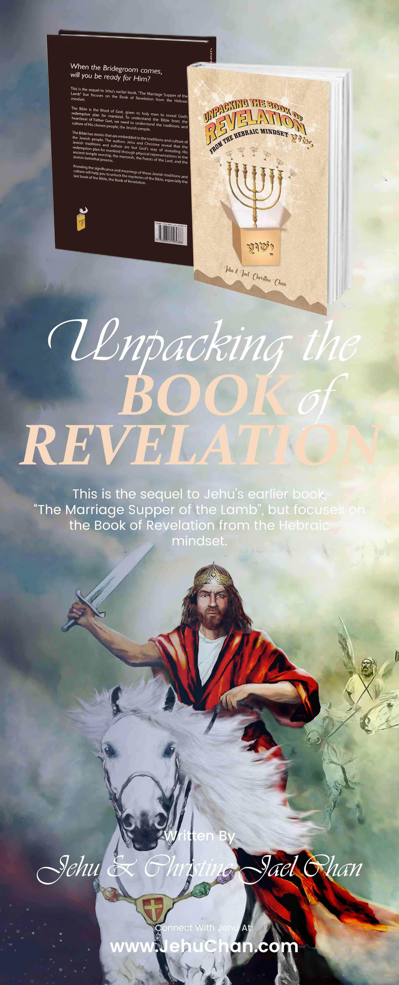
Are You Ready for Rapture?
Elder Jehu and Christine Chan
Saturday
16 Feb 2019
3 pm to 5pm
City Missions Church Conference Room
City Missions Church - Market Place Ministry
ICEJ Singapore www.jehuchan.com

Slide 2
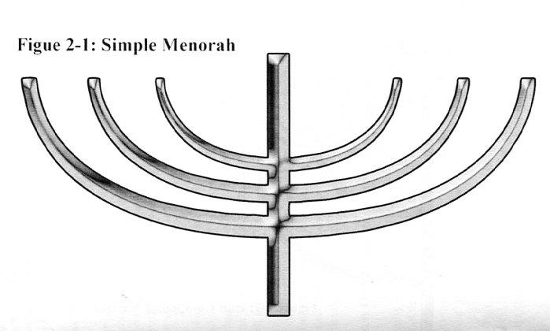
Thyatira
Laodiceans
Philadelphia
Smyrna
Ephesus
Sardis
Pergamos
Time

Slide 3
Seven Letters
3 separate groupings
Before Christ
After Christ
Millennium Rule and Reign
Before Christ
Ephesus – loveless church
Smyrna – persecuted church
Pergamos – compromising church
After Christ
Thyatira – corrupt church
Sardis – dead church
Philadelphia – faithful church
Millennium Rule and Reign
Laodiceans - lukewarm church

Slide 4
Seven Seals
First Seal
Birth of Islam
Second Seal
Psalm 83 War
Third Seal
Famine and Inflation
Fourth Seal
Ezekiel 38/39 War
Fifth Seal
Cries of the Martyrs
Six Seal & Seventh Seal
Harvest of the Bride
Return of Yeshua

Slide 5
AD
BC
Laodiceans
Philadelphia
Sardis
Thyatira
Pergamos
Smyrna
Ephesus
7th & 6th Seals
4th to 1st Seals
5th Seal
6,000 years
7000 years – 7 Letters

Slide 6
The Woes
The four earlier trumpets, God used nature to reflect His anger and bring punishment on the disobedient.
The remaining three woes, God released Satan and his hordes and allowed satan to play his own end game.
Satan then began to create his own race of people and corrupting and deceiving the rest of mankind, just as he did in Genesis.
They will be causing additional pain and suffering.
The fifth trumpet (first woe) we were introduced to Abaddon who released thousands of Teraphim out from the Abyss.
The Teraphim will make a covenant with Abaddon to attack God’s chosen people.

Slide 7
The Fifth Trumpet (First Woe)
Rev 9:1-12 Identification of the angel of the abyss as Abaddon (Apollyon)
Abaddon given the key to the abyss
Where does this key (Rev 9:1) come from?
When Jesus died on the cross, HE went down with the key to Gehenna (Hell) to set captives free. Until that moment Abaddon had the key.
Jesus took the key from Abaddon.
Abaddon was one of the two angels that rebelled against God and are the fallen angels.
Abaddon was the angel of life before he felled. He became the angel of death and possessed the key to Hell. He has the power to lock people away after they die because of their sin. He was the angel of death who passed over Egypt and killed all the first born who did not have the blood covering.

Slide 8
Cont’d…
When Yeshua died on the cross, He defeated satan. In the spiritual realm (heaven) Michael defeated satan and satan lost his place in heaven and fell to earth – Rev 12:7-9
Before Yeshua’s triumph over sin, satan was still able to come before the throne of God as he did back in the book of Job.
However, post-resurrection world, satan has been able only to function on earth and within its atmosphere.
Rev 1:17-18 clearly stated that Yeshua after the cross possesses the keys of death and of Hades.
For reason only known to God, Yeshua gave the key back to Abaddon so that in the future he would be able to unlock the abyss one last time to release the teraphim HE locked up back in Genesis.

Slide 9
Who’s in the Abyss?
Teraphim are the third and lowest form of angels and are able to take on human form.
In Genesis 6:4, those Teraphim who rebelled against God came to earth and had sex with women who gave birth to the Nephilim
The book of Enoch explains how these very same former angels were locked away in the abyss as punishment for their wickedness.
Rev 9:3-11 Abaddon opened and released the locusts from the pit.
The locusts are devils, not to confused with demons who are the offspring of Teraphim and mankind.
“Pain” in Hebrew signifies birth or labor pain.
The five month of pain could refer to the minimum five months for human fetus to be born.
So this could also mean that the Teraphim could come and again have sex with mankind to breed the Nephilim one more BIG time.
Daniel 2:43 talks about iron (fallen angels) and clay (mankind) mixing their seeds together.

Slide 10
The Sixth Trumpet (Second woe)
Second seal Rev 6:4 First War, Attackers are mostly Semitic people (Shem) with the exception of Canaanites (Ham) and Assyrians (Japheth}
Ps 83 prophesized this war.
Sixth Trumpet Rev 9:13-19 Second War
Ezekiel 38-39
Persia – believed to be – descendants of Japheth
Genesis 10:2 – through Japheth’s son Madai
The center of the Persian Empire today is Iran
Cush – grandson of Ham who migrated south to the Mt Ararat into Africa (Ethiopia, Sudan and southern Egypt
Phut or Put today represents the people who live in and around Libya, in northern Africa
Descendants of Ham

Slide 11
Second War - Ezekiel 38-39
Gomer – Gen 10:2 one of the sons of Japheth
Gomer’s descendants became known as Cimmerians
Lived in the region of the Caucus Mts and Black Seas, today known as Ukraine and part of Russia
Some scholars identify the Gomerites as the Armenians
Togarmah – son of Gomer and grandson of Japheth
Some scholars identify them as Armenians, Georgians and Turks
Magog/Gog – Magog is the second son of Japheth. Descendants as living north and northeast of the Black Sea. Today would be Russia
Meshech – son of Japheth. Josephus equated them as descendants of Tubal with the capital city of Georgia.
Tubal – son of Japheth. Lived in the area of the Black Sea. Ancestors of modern Georgians.
These nations come from descendants of Ham and Japheth. There are north and north east nations of Africa, excluding Egypt, Iran and Turkey, Russia.
3

Slide 12
Third War – Armageddon Rev 16:16
The last seven years before the return of Yeshua begin with the appearance of the two witnesses.
The two witnesses were given authority for 1260 days which is approximately 3½ years
At the end of 3½ years, they will be killed and then resurrected
Notice that the beginning of the 42 months (also 3½ years) will be identified by the blowing of the seventh trumpet (1 Cor 15:51-54) the last trumpet
The dead in-Christ …will meet the Lord in the air
The harvest (Rapture) of the Bride
The death of the two witnesses by Abaddon, the False Prophet also coincide with the False Messiah announcing to world that he is “God”
4

Slide 13
Some misinterpretations
Ezekiel 39:9 – refers to the destruction of the army of Gog. For seven years the weapons of Gog will be used to fuel fires in the land of Israel.
But why the time period of seven years?
When the Messiah returns, there will be no need to make such collections in the land of Israel for the land will be cleansed of such things , when Yeshua sets up His Kingdom.
Seven years, half where the two witnesses at work the second half where the the false Messiah reigns.
The last seven years begin at the middle of the sixth trumpet, then include the seventh trumpet and all the seven bowls.
The sixth trumpet divided into two sections, first Gog n Magog war and second, the two witnesses.
The 1260 days given to the two witnesses is the same as the 1,260 days given to the woman.
5

Slide 14
RE-CAP
The last seven years before the return of Yeshua begin with the appearance of the two witnesses.
The two witnesses were given authority for 1260 days which is approximately 3½ years
At the end of 3½ years, they will be killed and then resurrected
Notice that the beginning of the 42 months (also 3½ years) will be identified by the blowing of the seventh trumpet (1 Cor 15:51-54) the last trumpet
The dead in-Christ …will meet the Lord in the air
The harvest (Rapture) of the Bride
The death of the two witnesses by Abaddon, the False Prophet also coincide with the False Messiah announcing to world that he is “God”
4

Slide 15
6th Trumpet
Seven Proclamations
Ezekiel 38-39 War
After Ps 83 War
Rev 19:11-21
7th Trumpet
Seventh Trumpet
Temple Door closes – End of Evening worship
Seven Bowls
Tribulation
Great Tribulation
The two Witnesses
1000 yrs
42 mths
1260 days
Seven Years
1 Thess 4:16-17
1 Cor 15:52
2 Thess2:3-12

Slide 16
The Entire Timeline
Yeshua Returns
7 Trumpets
1000 yrs
7 Seals
7 Evil kingdoms
7 Letters
The 6,000-year time period will be followed immediately by the 1,000 year reign.
These two periods are separated by the return of our Lord Yeshua (Rev 19:11)

Slide 17
The Real Main Plot
Two Brides, Two Destinies
Rev 1 – God described Himself as the First and the Last, the Creator and also the Messiah who died but lives again.
Chapters 4 & 5, focused on the throne of God and the Messiah
Chapter 7 – God’s groomsmen, the 144,000
The thunder Chapters itself were one and the same – Chapter 10, 19-22
At this climax, Yeshua read the ketubah (thundered forth). God reveals to us His principles for holy living also the marriage obligations

Slide 18
The Curses - Sub Plot
Chapters 2 & 3
Chapters 6 & 8
Chapters 8,9, 11
Chapters 16
Chapter 13
Chapter 14:6-20

