Slide 1
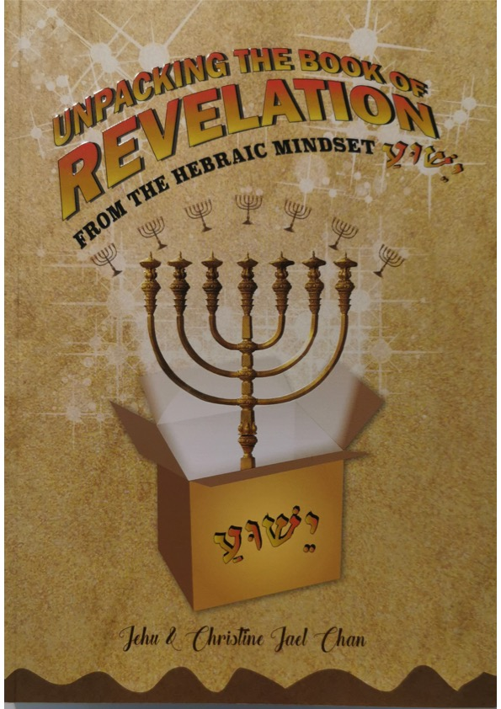
CMC
Sabbath Service
Jehu & Christine Chan
ICEJ
National Directors
Singapore
The Sounding of The 7 Trumpets
Come and Find Out When The Rapture Takes Place?
CMC Conference Room
#11-15 CT Hub
Singapore 339407
Saturday 21 Dec 2019
3 pm to 5 pm
www.icej.org
www.jehuchan.com

Slide 2
Revision
Chapter 1
the first shamash chapter introduced us to God the Father as Yeshua the Messiah, the aleph and the tav
The message He gave to John included a vision of Himself, surrounded by seven menorahs, representing the seven congregations to which John to write.
Chapters 2&3
Introduced the seven letters that occupy chapters 2&3
These chapters covered the first mini-menorah
These seven letters revealed God’s plan from creation all the way through His Second Coming to the end of the 1,000 year reign.
From Adam through David to Yeshua
Revealed certain things His followers to be aware and to guard against.
Gives encouragement and reward

Slide 3
Revision
Chapters 4&5
The next shamash chapters took us back to heaven and gave us a more detailed look at what was going on there.
God the Father was now seated on His throne with four cherubim standing guard on all four sides.
We saw 24 elders, wearing white garments and seated on thrones of their own that surrounded the throne of God.
We have now been introduced to the two major participants in the Wedding of the Lamb, beginning with the Groom and His Father.
We witness the first actual heaven-based event of the shamash chapters.
We saw the Lamb, standing as if slain who took the scroll and opened it. As bridegroom, He was legally empowered to do with his own ketubah at an ancient Hebrew wedding.

Slide 4
How the chapters are linked
The basic flow of the narrative is first an individual is introduced. Then we see what he or she does either in or during the wedding.
Then we see corresponding action played out and amplified by the corresponding mini-menorah that follows each shamash chapter.
Chapter 6
Explains and describes the events that occur at the “opening” of each of the seals. These events involve catastrophes on the earth, death and destruction.
Meanwhile the shamash chapters the sheep are being prepared for the wedding and the goats are being judged.
The only real difference here in Revelation is that the goats are being given one last opportunity to be invited.
Chapter 7 – The Sealing of the 144,000 & the Martyrs

Slide 6
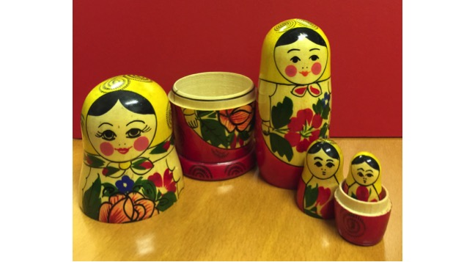
Russian Doll Analogy

Slide 7
Fifth Seal
Cry of the martyrs
Rev 6:9 – “slain for the word of God and for the testimony which they held.” compare with
Rev 12:11 – “And they overcame him by the blood of the Lamb and by the word of their testimony, and they did not love their lives to the death.”
Rev 7:14 “These are the ones who come out of the great tribulation, and washed their robes and made them white in the blood of the Lamb.”
Rev 20:4-6 They will reign with Jesus for a 1000 years

Slide 8
Opening of the Sixth Seal
Signs:-
Great earthquake
Sun became black and moon red
Stars of heaven fell to earth
Sky receded as a scroll
Rev 6:15-17 – “And the kings of the earth, the great men, the rich men, the commanders, the mighty men, every slave and every free man, hid themselves in the caves and in the rocks of the mountains, and said to the mountains and rocks, “Fall on us and hide us from the face of Him who sits on the throne and from the wrath of the Lamb! For the great day of His wrath has come, and who is able to stand?”
Language of the Great tribulation.

Slide 9
Timeline
Chp 21:1-8
Jesus returns with the martyrs
Chp 20:1-15
1000 years
Millennium Rule
New Heaven & New Earth
First Letter to Seventh Letter
Time line

Slide 10
Chapter Seven
“After these things” although John was shown the sealing of the 144,000 after the events he saw in the opening of the Sixth Seal
The Sealing takes place in preparation for the wedding feast.
It is the way Jewish people tell story, with an interlude inserted in the midst of the main plot.
Chapter 7 is also the chapter that leads into the Shamash chapter 8 which introduces the Seven Trumpets

Slide 12
Half an Hour silence
Opening of the seventh Seal – The finale ending in the consummation of the marriage of the Lamb
Trumpet chapters are Chapter 8,9 and 11, describe an ancient temple service
This service is seen in heaven, on which earthly services were based.
It begins on Friday morning and ends on Friday evening with the Erev Shabbat (Evening of the Sabbath) service.
This particular Erev Shabbath occurs once a year on the eve of Shavuot, (Pentecost) the fourth of the seven God-ordained Hebrew feasts.
In ancient times, each temple day would start at the rising of the sun with the opening of the temple gates. There are two services – morning and evening.

Slide 13
Daily Trumpet Blasts
During the course of the day, seven separate trumpet blasts were deployed at the temple as follows:-
One trumpet blast in the morning when the gates of the temple were opened.
Three more trumpet blasts during the morning service. Hence four blasts in the morning.
Three additional trumpet blasts during the evening service.
The above correspond to four disasters affect the earth, the atmosphere, and the seas and springs of water while the last three are called woes and are very different from the first four.

Slide 14
Timeline
7th Trumpet
6th Seal
2th Seal
Bride taken Up
Great Tribulation
3 ½
3 ½
1000 yrs
Erev Sabbath
1st to 7th Trumpets
First Seal to Seventh Seal
First Letter to Seventh Letter
Time line

Slide 15
Russian Doll Analogy

Slide 16
Timeline
7th Trumpet
Chp 20:7-15; 21:1-8
6th Trumpet
5th Seal
Chp 19-20:6
Chp 11:15-19: 14:14-16
2th Seal
Bride taken Up
Ezekiel 38-39 War
2 Witnesses
Great Tribulation
3 ½
3 ½
1000 yrs
1st to 7th Trumpets
First Seal to Seventh Seal
First Letter to Seventh Letter
Time line

Slide 17
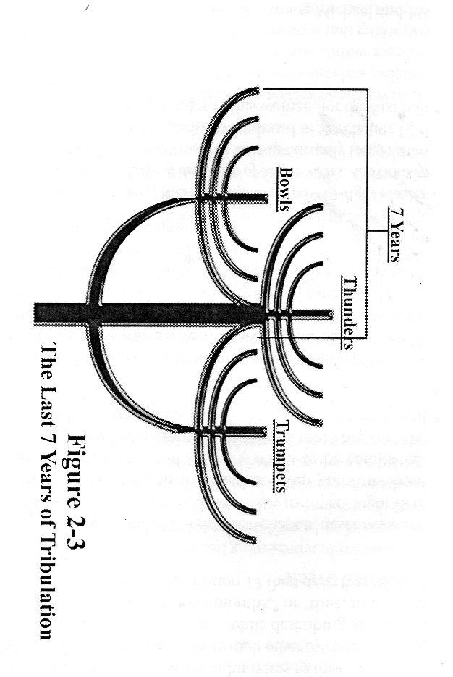
8 ½ lights in the 49-light master menorah

Slide 18
End of Lesson
Question Time

