Slide 1
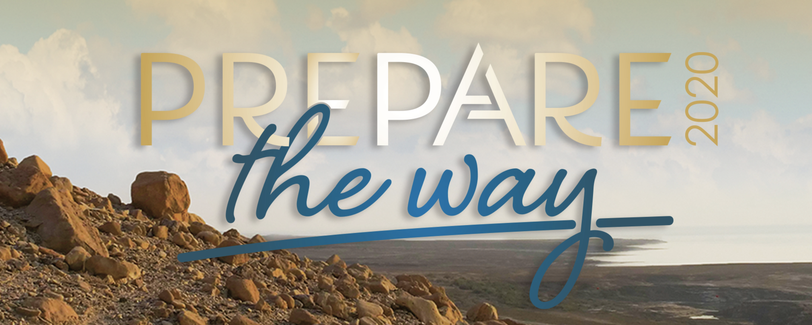
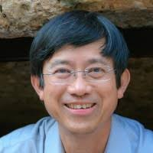
Sabbath Marketplace Service
GOD’s Names
“I will set him on high, because he has known My Name”- Psalm91:14b
Oct 17th 2020 (Sat) 3 pm to 5 pm
via ZOOM-Passcode (cmc777)
ID: 867 7443 4546
Elder Jehu Chan

Slide 3
ELOHIM - 2,250 X
God’s incredible power and might
The only True God
He is sovereign
One we can trust
The Mighty zone over all of nature
The Creator God
“In the beginning God created the heavens and the earth” - Genesis 1;1
“The heavens are telling of the glory of God; and their expanse is declaring the work of His hands” – Psalm 19:1

Slide 4
Elohim
Enabling barren women such as Sarah and Rebecca to conceive – Gen 18:10, Gen 18:14
Bringing oppressed people out of Egypt – Exodus 20:2
Power raising Jesus Christ from the dead – Rom 1:1-4
The name Elohim is fullness of divine power

Slide 6
YAHWEH – YHVH – The LORD 6,828X
Yahweh. Means “The Lord”
Derived from the Hebrew word for “I AM”
“I AM WHO I AM, I AM has sent me to. You.” – Exodus 3:13-14
One of full authority
He never changes
We can trust His living leadership in our lives
YHVH – tetragrammaton because of its four letters
Substituted name - Adonai

Slide 7
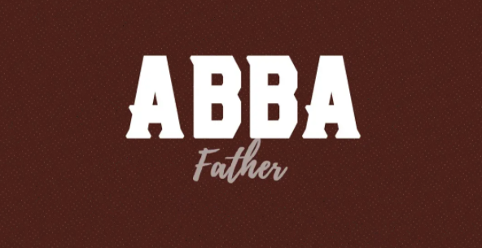

Slide 8
Abba – Father as in the Lord’s Prayer
Means “Daddy, Father”
The most intimate form of God’s name
Loving father
The One who can be fully trusted
The One we can lean on
The One who cares about all that concerns us
Unconditional love
We are His sons and daughters
“Because you are his sons, God sent the Spirit of his Son into our hearts, the Spirit who calls out, Abba, Father” Galatians 4:6

Slide 10
El Elyon – God Most High
The name used through the Old Testament revealing God is above all gods
One who reigns supreme
He is greater than any force of darkness in this world
He is bigger than any problem we might come up against in this life
God is in control
He has conquered death and sin
He is mighty
He is Lord and exalted over all
“I will praise the LORD according to his righteousness: and will sing praise to the name of the LORD most high” Psalm 7:17

Slide 12
El Roi – The God who sees
He is the one who sees and chases after us
He is watching over us
He follow us with goodness
He is the One who sees us when we feel lonely
Hagar experienced God as the El Roi, He is always close
“Then she called the name of the LORD who spoke to her, You-Are-the-God-Who-Sees; for she said, “Have I also here seen Him who sees me?” - Genesis 16:13

Slide 14
El Shaddai – God Almighty
He is all-powerful
He is the Mighty One – Ps 91:1
“He who dwells in the secret place of the Most High shall abide under the shadow of the Almighty”
We can find refuge and rest in His shadow

Slide 15
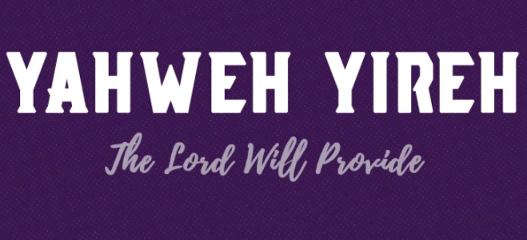

Slide 16
Yahweh Yireh – The Lord will provide
God will provide for our needs
He is faithful
He is able, nothing is too difficult for Him
Sometimes His timing is different than ours
Sometimes, we get our “needs” and “wants” mixed up
Other times He knows what is better for us
We can trust Him
His timing is perfect
Abraham found this to be true
“So Abraham called that place The Lord Will Provide. And to this day it is said, “On the mountain of the Lord it will be provided.” Genesis 22:14

Slide 18
Yahweh Nissi – The Lord is My Banner
God’s protection, leadership and deliverance for His people
As He provided protection for the Israelites against the Amalekites, He offers us protection and. Deliverance today from the enemies we may face in this life
Remember the story of the battle against the Amalekites?
We get weary, we get upset, we get angry and we end up losing it.
God reminder us He is our banner, our protector
If we only allow Him to be in control
“Moses built an altar and called it the LORD is my Banner” – Exodus 17:15

Slide 20
Jehovah Rapha – The Lord Who Heals You
He still heals you from your diseases, illness, brokenness, or painful circumstances
God knows we are in need of help
He understands you are. In need of healing
He promises to redeem every broken place in our lives
Sometimes the healing does not come in the timetable or way that we would choose
We will live forever free in heaven
He promises to make all things new
He said “If you listen carefully to the LORD your God and do what is right in his eyes, if you pay attention to his commands and keeps. All his decrees, I will not bring on you any of the diseases I brought on the Egyptians, for I am the LORD who heals you.” – Exodus 15:26

Slide 22
Yahweh Shalom – The Lord is Peace
God is the only One able to give us the peace that passes all our won understanding.
Example of Gideon
The enemies were strong
This was no peace
But God showed up strong and brought deliverance straight through fear-filled days
Gideon was led to build an altar to the Lord and call it “The LORD is Peace”
”The Gideon built an altar there to the LORD and names it The LORD is Peace. – Judges 6:24

